Slide 1
Directional Dependence using Copulas
Molly Olson
Faculty Mentor: Engin Sungur

Slide 2
Objectives
Understanding the ideas of directional dependence, copulas, and spatial statistics
Learn how to develop and the developing of new models
Ultimately, apply to data

Slide 3

Directional Dependence
Background and basic definitions:
Causal relationships can only be set through experiments
Not “direction of dependence”
Unemployment and education level
Depends on the ‘way’ it’s looked at or introduced
  Not limited to positive and negative dependence
Unemployment
Education Level
Notes:
-different from causal and direction on dependence
-manipulation to find which causes what
-. Direction of dependence implies changes in the behavior of underlying variables relative to the changes on other sets of variables. For instance, in bivariate setting, if large (small) values of the random variables tend to occur together then the direction of dependence is positive; and likewise if the large values of one variable tend to occur with small values of the other then the direction of dependence is negative.
-meaning we aren’t looking at the positive negative correlation. Correlation doesn’t imply causation
-correlation doesn’t help us here- not limited to positive and negative dependence
-so directional dependence includes not just the positive/negative relationship, but also the pattern changes.

Slide 4
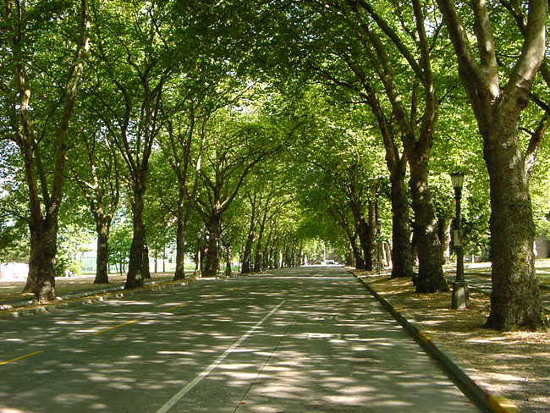
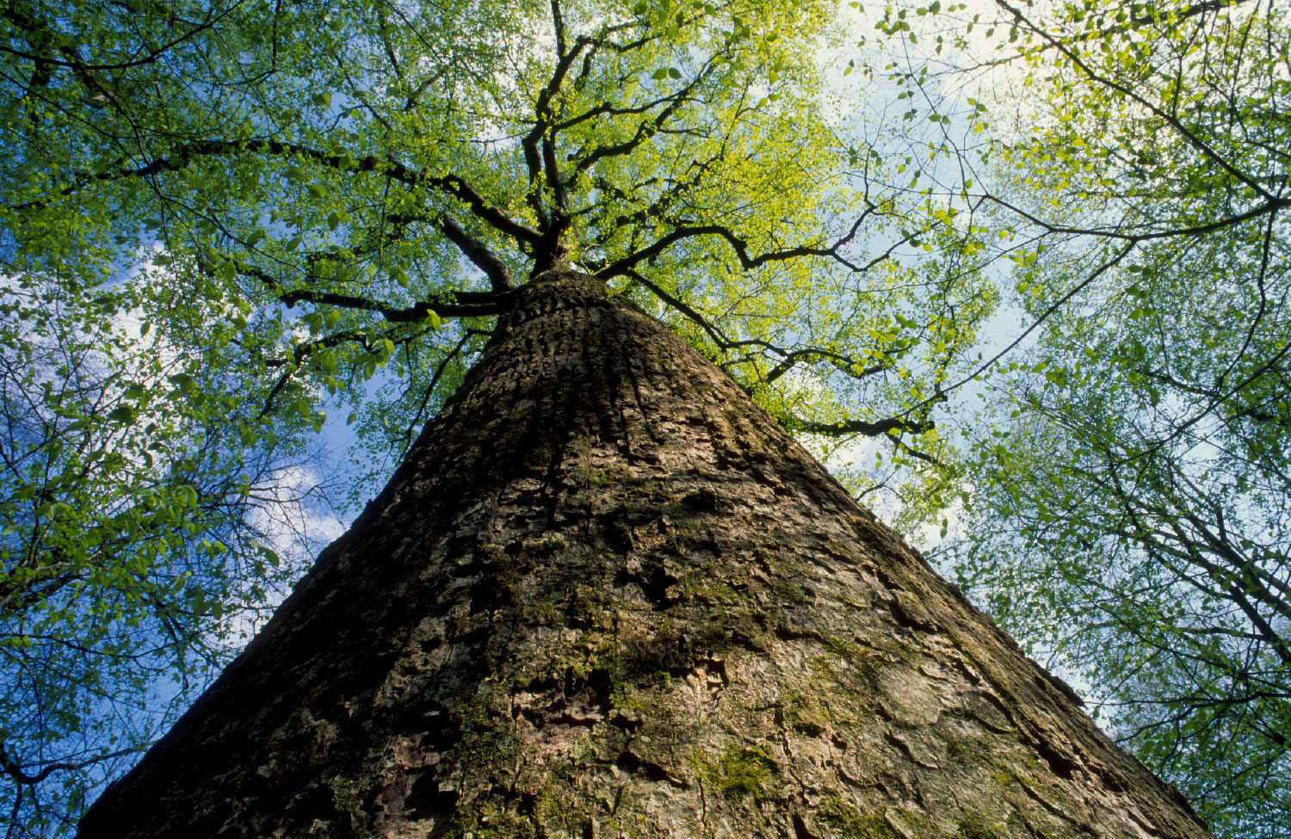
Directional Dependence
Background and basic definitions:
To better understand
http://www.upwithtrees.org/wp-content/uploads/2013/07/trees-566.jpg
http://assets.byways.org/asset_files/000/008/010/JK-view-up-tree.jpg?1258528818
Notes:
All about perspective a simple change can change the effect of the image produced
-we are going to change the angles to change how we look at it and understand the dependence

Slide 5
Copulas
Background and basic definitions:
Notes:
X1-Xk, and each has their own marginal distribution fcn. Which then can be combined into a joint CDF. But we don’t want to deal with different marginals, so we transform them all into uniform on (0,1). “copulas are multivariate distribution functions whose one dimensional margins are uniform on the interval (0,1).

Slide 6
Copulas
Background and basic definitions:
Multivariate functions with uniform marginals
Eliminate influence of marginals
Used to describe the dependence between R.V.
Notes:
Right now we like them for reasons of, amongst others,
Used when we don’t want to deal with all of the different marginals to tell the dependence and is a way of studying scale free measures of dependence.

Slide 7
Directional Dependence and Copulas
Background and basic definitions:
Symmetric.
  Example: Farlie-Gumbel-Morgenstern’s family
  C_{θ}(u, v) = uv + θuv(1 − u)(1 − v)
If then we say the pair (U,V) is directionally dependent in joint behavior
Notes:
-all of the copula families are symmetric. Since correlation doesn’t help us determine which direction, if they are symmetric it wont help either.

Slide 8
Spatial Statistics
Background and basic definitions:
2012, Orth
Now
Notes:
To overcome this obstacle, our approach to this research is based on a set up that is commonly used in spatial statistics. When we talk about spatial statistics, we are talking about working with spatial data. That is, data that is associated with a location in space. This type of data is common in many different areas ranging from epidemiology to astronomy. It can even be found in brain imaging when trying to locate areas of stimulation when a patient is asked to perform different tasks. We can view the areas that light up in the brain as being spatial data. We replace latitude and longitude with any two variables.
We generalize this approach to spatial statistics and replace spatial correlations with ordinary correlations through a general framework of rotations and projections of the two dimensional coordinates of a map onto a single axis making angle θ with the horizontal (east-west) axis. This helps us visualize the dependence structure in a meaningful way. Simon considers observed values of a random variable X at n locations that each can be identified with a point (s, t) in the coordinate system. Consideration of an angle θ, such that θ=0 (θ=90) showing the direction of east (north), gives us an opportunity to plot dependence measure as a function of the angle. We use θ as an index, define Pθ=scosθ+tsinθ, and work on the Pearson’s correlation between X and Pθ. The Pθ can be interpreted as the X’s “coordinate” along the axis pointing in the direction θ, i.e., the dot product of the original point by a normalized length vector cosθ, sinθ.
The top equation here can be interpreted as the random variable U’s ‘coordinate’ along the axis pointing in the direction theta. In other words, it is the dot product of the original point/location by a normalized length vector
(cos(theta), sin(theta)).
We will use this linear combination of the variables to consider the distributional properties of (U, Pvw(theta)) and measures of dependence between U and Pvw(theta).

Slide 9
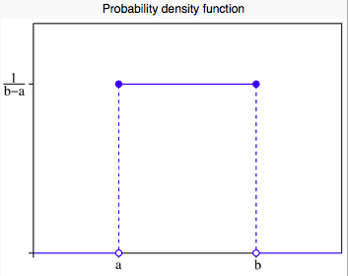


Procedure
Start with U₁, U₂, U₃, U₄
Uniform distribution
http://en.wikipedia.org/wiki/Uniform_distribution_%28continuous%29
Notes:
So what I did was: start with U1,U2,U3,U4 which are independently generated sets of 250 numbers with a uniform distribution from 0 to 1.
For those of you unfamiliar with the uniform distribution, the probability density function is…
And the probability density function’s graph is____
This is saying that each random variable is equally likely to take on a number from 0 to 1 (or whatever your interval might be)
And the cumulative distribution function is ____
So basically this is saying the probability of a number being between 0 and .5 is (.5-0)/(1-0)=.5.
We also know the expected value is (a+b)/2
Variance is (b-a)^2/12

Slide 10
Procedure
Notes:
So we wanted to make sure our uniform generated numbers held actually acted like a uniform distribution and that they were independent of eachother. So I produced graphs in R studio and they all showed up like this.
This is a histogram of U4.

Slide 11



Procedure
Notes:
So after all that, I started to simulate the projections. The rotations look like this. This is one I focused on a lot.
We change the way we look at it by changing the angles.
Now, the P’s are dependent and no longer uniform, but we don’t know which ‘direction they are.’
If we could find the JCDF, we would be able to find a copula for this that wouldn’t be symmetric and be able to tell the direction.

Slide 12
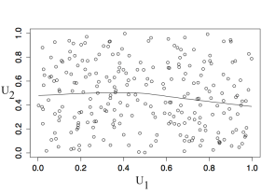
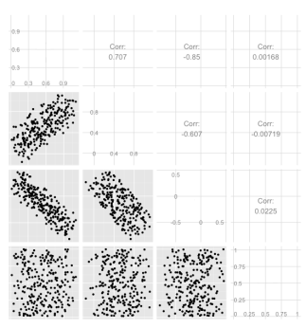
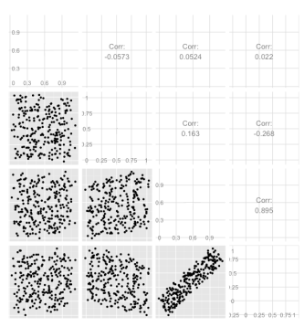
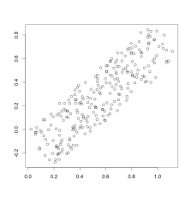
Procedure

Slide 13
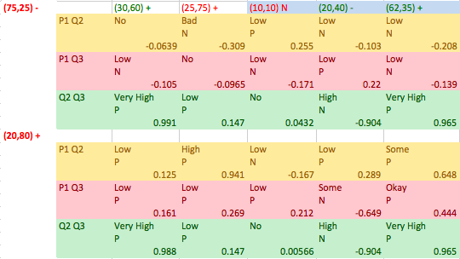
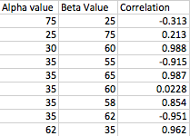
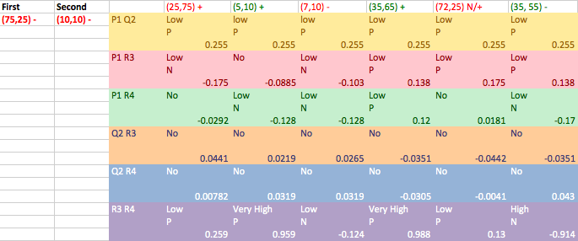

Slide 14
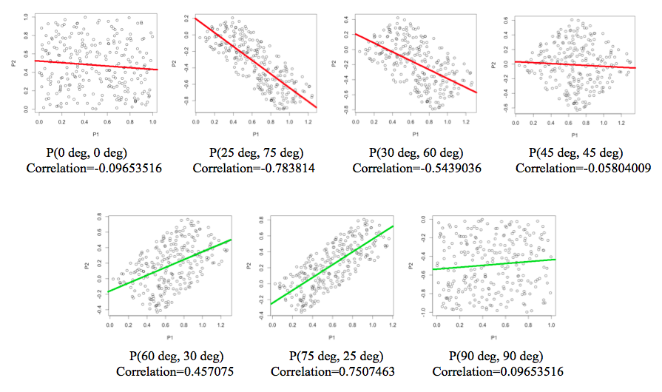
Procedure
Notes:
Here is how we can look at the data in different “ways”

Slide 15
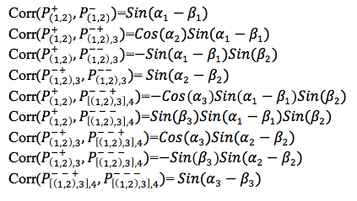
Process
Find exact correlations
We know correlations between U_{i}’s are 0
Notes:
Covariance equation
Correlation equation
Why correlations between uis are 0

Slide 16
Result
2012
One angle
Notes:
Here is an example of an angular correlation graph. We would like to do something like this, but we have 3 variables. So ours would need to be 3D. But the highest correlation is maximized at the outter most parts.

Slide 17
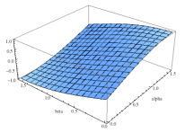
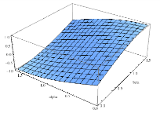
Result
Theorem 1. Suppose that (U_{i},U_{j}) are independent uniform random variables on the interval (0,1).
Define P₁=cos(α)U_{i}+sin(α)U_{j} and P₂=-sin(β)U_{i}+cos(β)U_{j}. Then,
(1)
(2) Cor(α,β)=-Cor(β,α)
(3) If α=β=θ, then (P₁,P₂) are independent.
Sin(β-α)
Sin(α-β)

Slide 18
Result
Theorem 2. Suppose that (U₁,U₂,U₃,U₄) are independent uniform random variables on the interval (0,1). Define

Slide 19
(1)
Then
(2)
(3)
(4)
(5)
(6)

Slide 20

Result
Then, a matrix plot of where

Slide 21
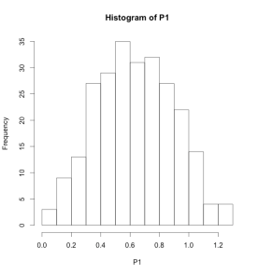
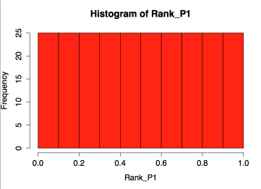
Result
Not uniform anymore
Rank

Slide 22
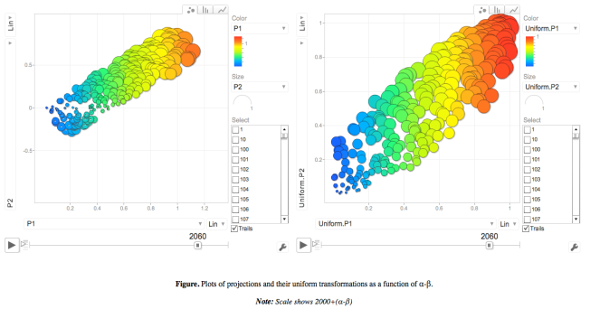
Simulation
Motion Chart

Slide 23
Future Research
Explore properties up to ‘n’ variables
Find a copula with directional dependence property
Apply these methods to a data set

Slide 24
References
[1] Nelsen, R. B., An Introduction to copulas (2nd edn.), New York: Springer, 2006
[2] Sungur, E.A., Orth, J.M., Constructing a New Class of Copulas with Directional Dependence Property by Using Oblique Jacobi Transformations, 2012
[3] Sungur, E.A., Orth, J.M., Understanding Directional Dependence through Angular Correlations, 2011

